Slide 1
How our Congregation Works

Slide 2
How we are different
Traditional churches are creedal—membership depends on agreeing with certain beliefs or a creed.
UU congregations/fellowships are based on a covenant—an agreement of how we want to be together.
As a congregation, we have a covenant with our association of congregations which includes seven principles.

Slide 3
The Seven Principles
We, the member congregations of the Unitarian Universalist Association, covenant to affirm and promote
The inherent worth and dignity of every person;
Justice, equity and compassion in human relations;
Acceptance of one another and encouragement to spiritual growth in our congregations;
A free and responsible search for truth and meaning;
The right of conscience and the use of the democratic process within our congregations and in society at large;
The goal of world community with peace, liberty and justice for all;
Respect for the interdependent web of all existence of which we are a part.

Slide 4
The Six Sources
The living tradition which we share draws from many sources:
• Direct experience of that transcending mystery and wonder, affirmed in all cultures, which moves us to a renewal of the spirit and an openness to the forces which create and uphold life;
• Words and deeds of prophetic people which challenge us to confront powers and structures of evil with justice, compassion and the transforming power of love;
• Wisdom from the world's religions which inspires us in our ethical and spiritual life;
• Jewish and Christian teachings which call us to respond to God's love by loving our neighbors as ourselves;
• Humanist teachings which counsel us to heed the guidance of reason and the results of science, and warn us against idolatries of the mind and spirit;
• Spiritual teachings of Earth-centered traditions which celebrate the sacred circle of life and instruct us to live in harmony with the rhythms of nature.

Slide 5
How we are related to the larger movement
We are a member congregation to the Unitarian Universalist Association (UUA) and send delegates to the annual General Assembly (GA) to vote on the national organizations by-laws and public witness statements.
The UUA provides resources to congregations (religious education materials, leadership training, ministerial search process, etc.), but it doesn’t tell us what to do.

Slide 6
How UUC operates
Each UU congregation or fellowship has “congregational polity,” which means that they are independent, self-governing entities.
The Bylaws are our governing document. They describe our purpose, how to become a member, the rights of membership, rules for congregational meetings, the governance and financial structures, and the process for calling a minister.
The Board of Trustees has fiduciary responsibility for the congregation.

Slide 7
The Congregation as a whole makes six really important decisions:
It adopts governing By-Laws.
It elects the Board.
It calls a Minister.
It creates and lives by statements of Mission and Covenant.
It elects Trustees to “own” property in the name of the Congregation.
It adopts the annual Congregational budget.

Slide 8
The Board has ﬁve principal functions:
It is the organizational custodian of the Congregation’s values and vision as expressed in our Mission, and is charged to support that Mission in all decision-making on behalf of the Congregation.
It considers and ratiﬁes the formal “big picture” policies by which the congregation advances its stated Mission on an ongoing basis.
It manages adherence to provisions of the By-Laws, such as annual meetings.
It ratiﬁes the selection of chairs for some committees.
It takes all personnel actions related to paid staﬀ, such as hiring, ﬁring, and compensation.

Slide 9
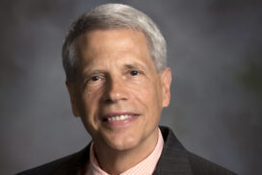
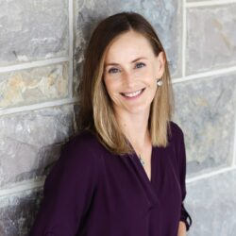
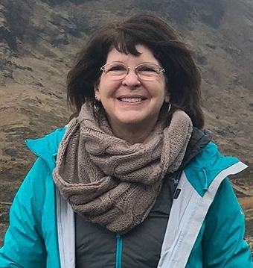
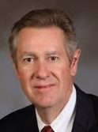
UUC Executive Board Officers
President-Elect
President
Fred Piercy
Laura Robinson
Secretary
Beth McClellan
Treasurer
Wayne Neu

Slide 10
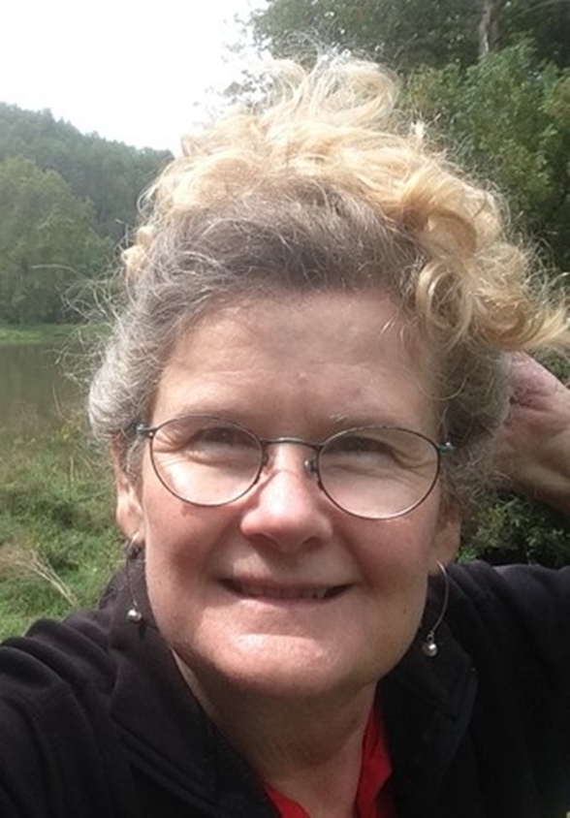
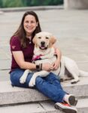
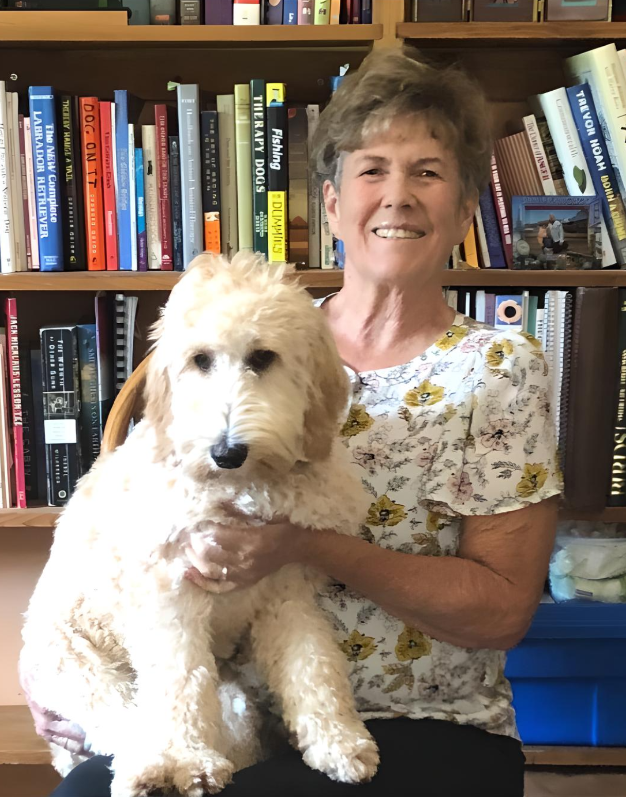
At-Large Board Members
Barbara Taylor
Rami Steinruck
Margo Walters

Slide 11
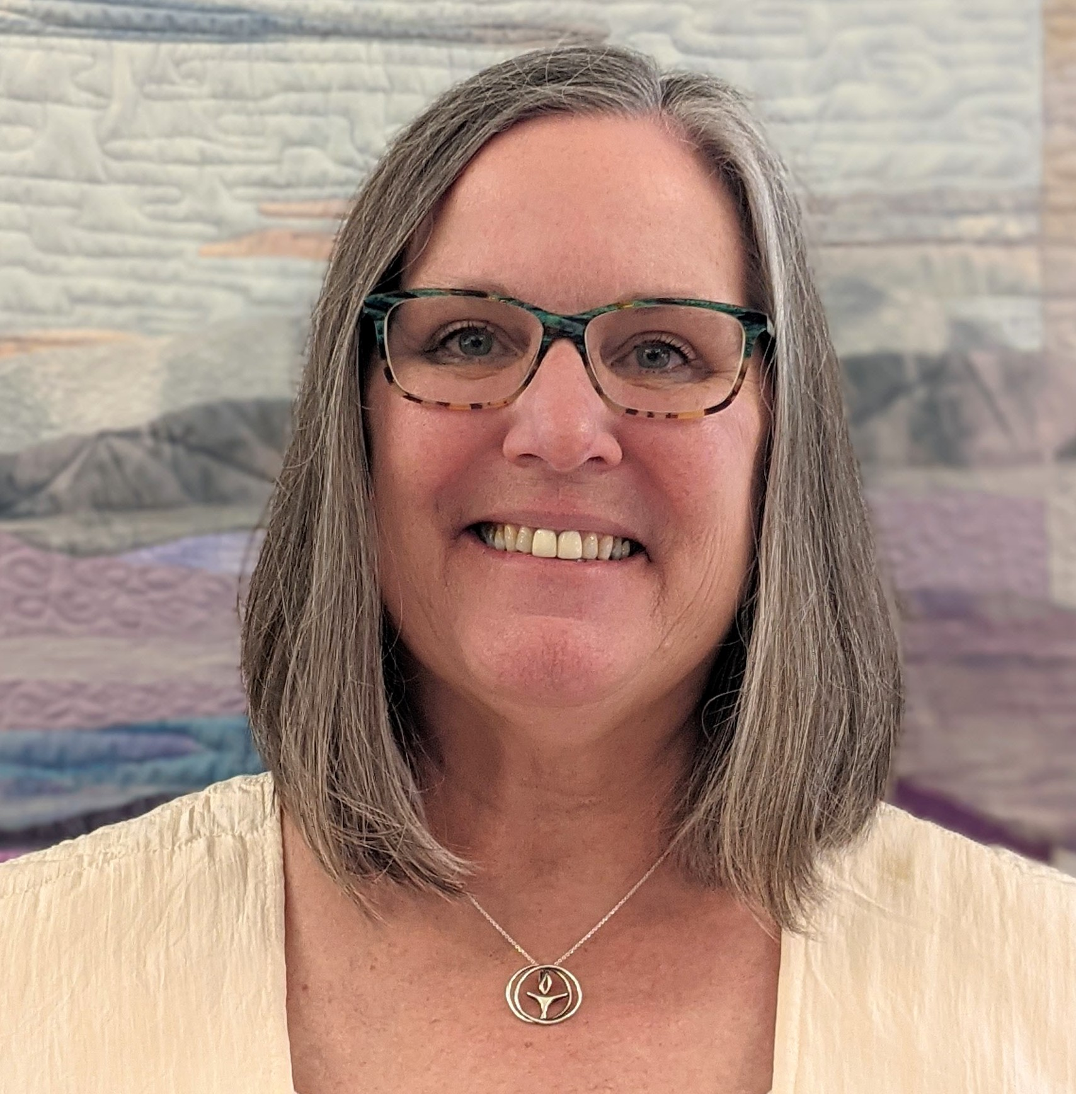
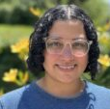
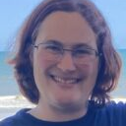
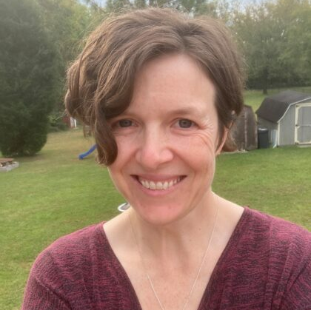
UUC Staff
Minister
Rev. Pam Philips
Administrator
Ericka Kelly
Intern
Minister
Anna Tulou
Director of Lifespan
Faith Development
Rachel Craine

Slide 12
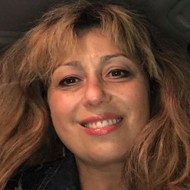
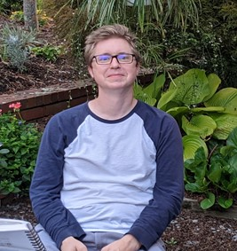
UUC Staff
Choir Director
Ella Kromin
Pianist
Jared Gibbs

Slide 13
The Ministries of the Church include these areas:
Lifespan Faith Development
Worship
Pastoral Services
Social Action
Stewardship
Membership Recruitment and Engagement

